Slide 1
# 1
Statistical Considerations for using Real-World Evidence in Clinical Studies
Yueqin Zhao, PhD
Office of Biostatistics, Center for Drug Evaluation and Research, FDA
Prepared for BBSW 2021

Slide 2
Disclaimer
This presentation reflects the views of the author and should not be construed to represent FDA’s views or policies.

Slide 3
Take-home Messages
RWD/RWE bring growing opportunities for medical products research and evaluation while maintaining current evidentiary standards.
Popular RWE designs include pragmatic trials, trial + external controls, and observational studies.
The design/implementation of RWE faces many new challenges, including fitness for use, data availability and quality, and bias control.
Quantitative approaches (e.g., causal methods) play a critical role in the conduct of RWE study from conceptualization, design, analyses, interpretation to communication.

Slide 4
Outline
Introduction
Examples of RWD/RWE Designs
Pragmatic trials
Trial+ external controls
Observational studies
Statistical Considerations
Fitness for use
Bias Controls
Data Format and Submission
Summary

Slide 5
What is RWD and RWE?
Real World Data (RWD) are data relating to patient health status and/or the delivery of health care routinely collected from a variety of sources.
Real World Evidence (RWE) is the clinical evidence regarding the usage and potential benefits or risks of a medical product derived from analysis of RWD

Slide 6
RWD/RWE: What Are the Goals?
Traditional RCTs typically
Use select groups of patients
Involve special infrastructure and data collection
Maximized sensitivity
RWD/RWE
Reflect the diversity of patients and actual health-care practices
Improve efficiency by making use of existing data and infrastructure

Slide 7
21st Century Cures Act (2016)
establish a program to evaluate the potential use of real world evidence-
to help to support the approval of a new indication for a drug approved under section 355(c) of this title; and
to help to support or satisfy post-approval study requirements.
No change in evidentiary standard
SEC. 505F. UTILIZING REAL WORLD EVIDENCE. Amended by Food and Drug Administration Reauthorization Act 2017

Slide 8
Substantial Evidence
Substantial Evidence
“evidence consisting of adequate and well-controlled investigations, including clinical investigations, by experts qualified by scientific training and experience to evaluate the effectiveness of the drug involve on the basis of which it could fairly and responsibly be concluded by such experts that the drug will have the effect it purports or is represented to have under the conditions of use prescribed, recommended, or suggested in the labeling or proposed labeling thereof.” Federal Food, Drug, and Cosmetic Act 1962
Drug Regulation History: https://www.fda.gov/about-fda/histories-product-regulation/historical-case-studies-drug-regulation

Slide 9
Adequate & Well-Controlled Study
Clear objectives, summary of methods & results
Design permits a valid comparison with a control (concurrent and historical controls)
Adequate selection of patients
Assigning patients to treatment and control groups minimizes bias
Adequate measures to minimize biases on subjects, observers, and analysts
Well-defined and reliable assessment of subjects’ responses
Adequate analysis to assess drug results
Ordinarily randomization
Blinding
Regulations 21CFR314.126

Slide 10
Wide Spectrum of Potential Uses of RWD/RWE in Clinical Studies
Randomized interventional
Non-randomized
interventional
Non-randomized
non-interventional
Randomized Trial
Using RWD Elements
Trials in Clinical Practice Settings
Observational Studies
RWD to assess enrollment criteria/ trial feasibility
eCRF + selected outcomes identified using EHR/claims data
RCTs with pragmatic design elements
Prospective data collection
RCT using eCRF
(+/- EHR data)
RCT using claims and EHR
– pragmatic design
Single arm study using external control
Registry trials/study
Prospective Cohort
Study
Mobile technology
used to capture supportive endpoints (e.g., to assess ambulation)
Using existing databases
RWD to support site selection
Case-control
Retrospective Cohort Study
Increasing reliance on RWD
RCT
Pragmatic RCTs/RWE
Observational studies
Courtsey of Peter Stein

Slide 11
Examples: Pragmatic Trials
DAPA-MI
Does the use of Dapagliflozin reduce the risk for cardiovascular death and heart failure related hospitalization among non-diabetic patients with acute heart attack?
Multicenter, registry-based, placebo-controlled RCT
Pragmatic
Registry-based (in Sweden and UK)
Prospective data collected from routine care
Mobile App to monitor patients
“Clever Cap” technology to allow monitoring drug adherence

Slide 12
Examples: Trial + External Controls
There have been many examples in
Oncology/Hematology
Rare Diseases
Notes:
Ethical or operational reasons

Slide 13
Examples: Observational Studies
Prograf: organ injection in lung transplantation
Retrospective non-interventional study
Data Source: nationwide Scientific Registry of Transplant Recipients (SRTR), compared to historical control
Primary endpoint: graft failure or death within 1 year after transplantation
The drug was approved to prevent organ injection among those receiving lung transplantation

Slide 14
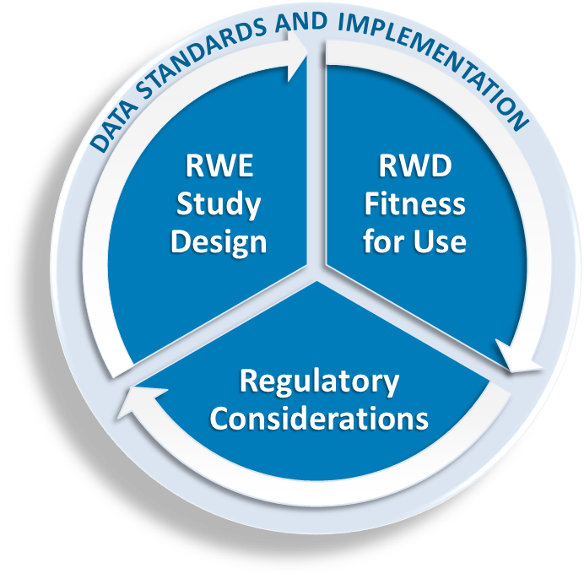
https://www.fda.gov/downloads/ScienceResearch/SpecialTopics/RealWorldEvidence/UCM627769.pdf

Slide 15
Statistical Considerations
Fitness for Use
Study Design
Data Source
Bias Controls
Investigator Bias: Pre-specify and Blinding!!
Selection Bias
Information Bias
Confounding Bias
Data Format and Submission
Levenson et al.(2021) Biostatistical Considerations When Using RWD and RWE in Clinical Studies for Regulatory Purposes: A Landscape Assessment. Statistics in Biopharmaceutical Research

Slide 16
Statistical Considerations in Pragmatic Trials
Fitness for Use
Patient Followup
Bias Controls
Randomization/Blinding
Outcome Validity

Slide 17
Statistical Considerations in Trial + External Controls
Fitness for Use
Comparability of Treated and External controls
Concurrent control vs historical control?
Active control vs placebo?
Time zero?

Slide 18
Statistical Considerations in Trial + External Controls
Bias Control
Design
Matching, restriction
Blinding
Analysis
Restriction, matching, weighting, stratification, regression
Blinding

Slide 19
Statistical Considerations in Observational Studies
Fitness for Use
A placebo-controlled trial?
Blinding is crucial?
Treatment strategies does not exist in real world setting?
Treatment adherence is required?
Tight monitoring is needed?
Observational studies won’t be suitable!

Slide 20
Statistical Considerations in Observational Studies
Bias Control
Design
Analysis
Quantitative Bias Analysis -- Unmeasured confounding
Instrumental Variables
Differences-in-differences
Bayesian Twin Regression
PS-calibration

Slide 21
Statistical Considerations in Observational Studies
Data Format and Submission
What to submit?
RCT → CRF, STDM, Adam, CDISC
RWE → ?
How to submit?
RCT → Gateway
RWE →Cloud-based?
Transparency and Reproducibility

Slide 22
Summary
RWD/RWE bring growing opportunities for medical products research and evaluation while maintaining current evidentiary standards.
Popular RWE designs include pragmatic trials, Trial + external controls, and observational studies.
The design/implementation of RWE faces many new challenges, including fitness for use, data availability and quality, and bias control.
Quantitative approaches (e.g., causal methods) play a critical role in the conduct of RWE study from conceptualization, design, analyses, interpretation to communication.

